Slide 1
YouTube Content Performance Optimization
Team Members:
Brandy, Huijuan, Madilyn, Nivi, Steve
Notes:
Today, we’ll walk you through our project focused on optimizing YouTube content performance.
As digital media continues to grow, content creators and marketers need tools that can help them analyze and enhance their video strategies.
Our project builds such a solution, combining real-time data collection, machine learning analysis, and visualization tools.
Our team has

Slide 2
01
02
Problem Statement
Why It Matters
03
04
High-level Architecture
Methodology
ML Analysis
07
Visualization Analysis
05
06
Metrics
Notes:
This is our agenda well introduce

Slide 3
Domain
Digital Media & Content Analytics

Slide 4

Background
Over 500 hours of video are uploaded to YouTube every minute
YouTube has over 2.7 billion monthly active users globally
The rise of compact, high-quality devices like the DJI Pocket 3 empowers everyday users to create professional videos
Notes:
As we all know YouTube is an immensely competitive platform, with over 500 hours of video uploaded every minute.

Slide 5
Problem Statement
This project aims to build a real-time data pipeline using the YouTube Data API to analyze video performance and uncover patterns that drive view counts and engagement, and deliver actionable insights through machine learning models and an interactive dashboard.
Content creators struggle to understand which factors truly drive viewership and engagement
A lack of real-time, data-driven tools that can guide content optimization
Manual tracking and guesswork often result in underperforming content and wasted effort or ad spend
Notes:
With so many videos in Youtube, some problems arise. ….
Creators often struggle to understand what makes content successful.
There’s a lack of real-time, data-driven tools to guide content decisions.
Therefore this project aims to build a real-time pipeline using the YouTube Data API to analyze performance data and derive insights using machine learning and dashboards.

Slide 6
Why It Matters
For Content Creating
For Marketing and Brand
Helps identify what content strategies lead to higher view counts and engagement
Enables data-driven decisions on video length, tags, titles, and posting time
Detect underperforming videos and suggest areas of improvement
Optimizes YouTube as a marketing channel using measurable insights
Supports campaign evaluation and performance benchmarking across categories
Allow marketing and media teams to track video effectiveness over time
Notes:
This work matters for both creators and marketers.
For content creators, it helps answer key questions like what length works best, when to post, or which tags improve reach.
For marketing teams, it transforms YouTube into a measurable and optimizable channel—enabling better campaign analysis, A/B testing, and performance benchmarking over time.

Slide 7
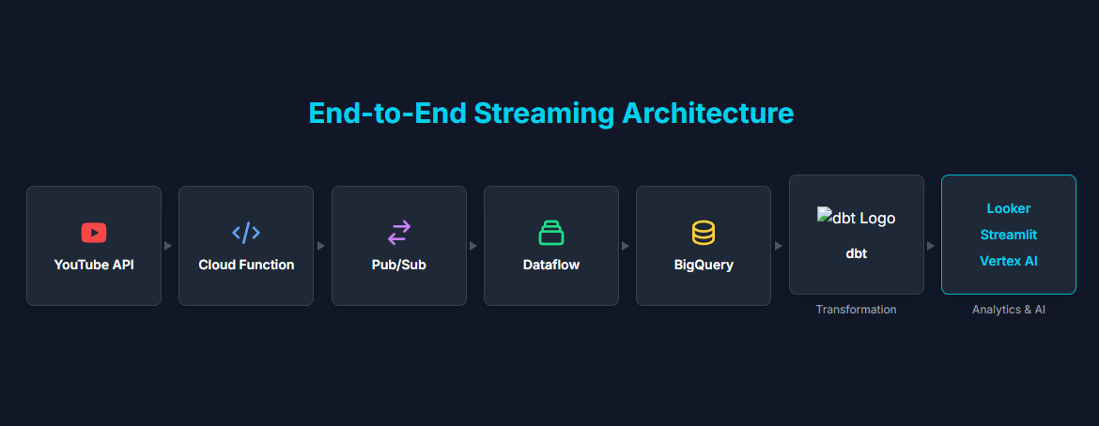

Notes:
Here’s a high-level view of our architecture. We ingest data from the YouTube Data API and store it in BigQuery via Pub/Sub and Dataflow. From there, we use Vertex AI to train and deploy machine learning models. Finally, the results are visualized in an interactive dashboard using Streamlit. This pipeline ensures fresh, actionable insights at any time. Now I ‘ll hand over to Madilyn addressing our metrics

Slide 8
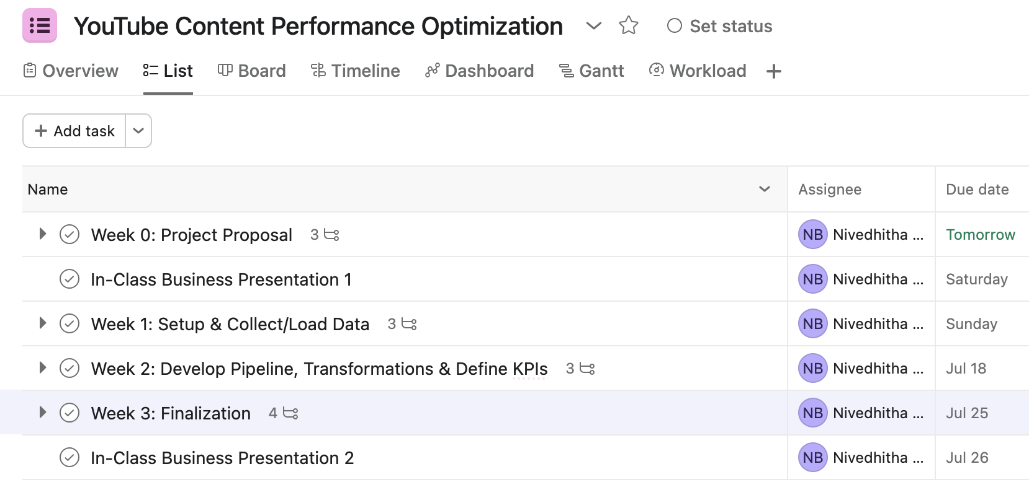
Roadmap

Slide 9
Key Metrics
Metadata: Video ID, title, description, tags, category, published date
Performance Metrics
View Count
Like Count
Comment Count
Channel Information
Subscriber Count (if public)
Total Video Count
Derived: Engagement Rate
Notes:
In this slide, I’ll walk through the key metrics we’ll be using to analyze YouTube content performance.
We're collecting data directly from the YouTube Data API v3, which gives us three major types of information.
Video metadata includes details like ….
Performance metrics cover core engagement indicators such as views, likes, and comments.
And from the channel side, we’re capturing subscriber counts and total video count, when available.
A key derived metric is the engagement rate, calculated as the sum of likes and comments divided by views. This gives a normalized view of how engaging a video is, regardless of total reach.
=
These metrics serve multiple purposes:
They enable category-based segmentation, such as comparing what works best in Music vs. Education.
They help benchmark upload strategies, like optimal title length or best upload times.
Finally, these structured insights also power LLM-based summaries, making it easier for users to ask natural-language questions like ‘What makes a tech video go viral?’ and get meaningful, data-backed answers.
So overall, these metrics form the backbone of our optimization pipeline, connecting raw API data to actionable content strategies.
Deliverables: our final deliverable is a
- Website
- live dashboard showing performance metrics and filters (title, category, tag)
- a chat bot

Slide 10
Updated Key Metrics
Performance Metrics
subscriber_growth = subscriber_count / channel_age_days
upload_frequency = videos_count / channel_age_days
views_per_upload = view_count / video_count
engagement_per_upload = (like_count + comment_count) / video_count
subscriber_per_upload = subscriber_count / video_count
Notes:
In this slide, I’ll walk through the key metrics we’ll be using to analyze YouTube content performance.
We're collecting data directly from the YouTube Data API v3, which gives us three major types of information.
Video metadata includes details like ….
Performance metrics cover core engagement indicators such as views, likes, and comments.
And from the channel side, we’re capturing subscriber counts and total video count, when available.
A key derived metric is the engagement rate, calculated as the sum of likes and comments divided by views. This gives a normalized view of how engaging a video is, regardless of total reach.
=
These metrics serve multiple purposes:
They enable category-based segmentation, such as comparing what works best in Music vs. Education.
They help benchmark upload strategies, like optimal title length or best upload times.
Finally, these structured insights also power LLM-based summaries, making it easier for users to ask natural-language questions like ‘What makes a tech video go viral?’ and get meaningful, data-backed answers.
So overall, these metrics form the backbone of our optimization pipeline, connecting raw API data to actionable content strategies.
Deliverables: our final deliverable is a
- Website
- live dashboard showing performance metrics and filters (title, category, tag)
- a chat bot

Slide 11
Updated Key Metrics
Why we want to update or performance metrics?
Ratios > Raw Counts: Metrics like views_per_upload and subscriber_growth_rate provide deeper insight than just totals.
Fair Comparison: Normalized metrics allow performance comparison across channels of different sizes and ages.
More Goal-Orientation: The updated metrics highlight areas for improvement (e.g., low engagement or growth rate).
Progress Tracking: Rate-based metrics reflect ongoing momentum, not just accumulated numbers.
Smarter Decision-Making: These insights help guide content strategy and resource allocation more effectively.
Notes:
In this slide, I’ll walk through the key metrics we’ll be using to analyze YouTube content performance.
We're collecting data directly from the YouTube Data API v3, which gives us three major types of information.
Video metadata includes details like ….
Performance metrics cover core engagement indicators such as views, likes, and comments.
And from the channel side, we’re capturing subscriber counts and total video count, when available.
A key derived metric is the engagement rate, calculated as the sum of likes and comments divided by views. This gives a normalized view of how engaging a video is, regardless of total reach.
=
These metrics serve multiple purposes:
They enable category-based segmentation, such as comparing what works best in Music vs. Education.
They help benchmark upload strategies, like optimal title length or best upload times.
Finally, these structured insights also power LLM-based summaries, making it easier for users to ask natural-language questions like ‘What makes a tech video go viral?’ and get meaningful, data-backed answers.
So overall, these metrics form the backbone of our optimization pipeline, connecting raw API data to actionable content strategies.
Deliverables: our final deliverable is a
- Website
- live dashboard showing performance metrics and filters (title, category, tag)
- a chat bot

Slide 12
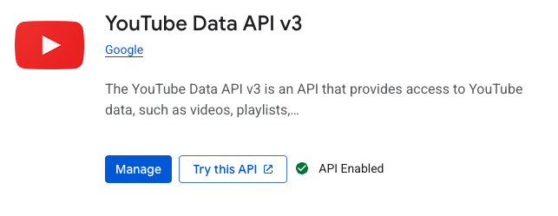
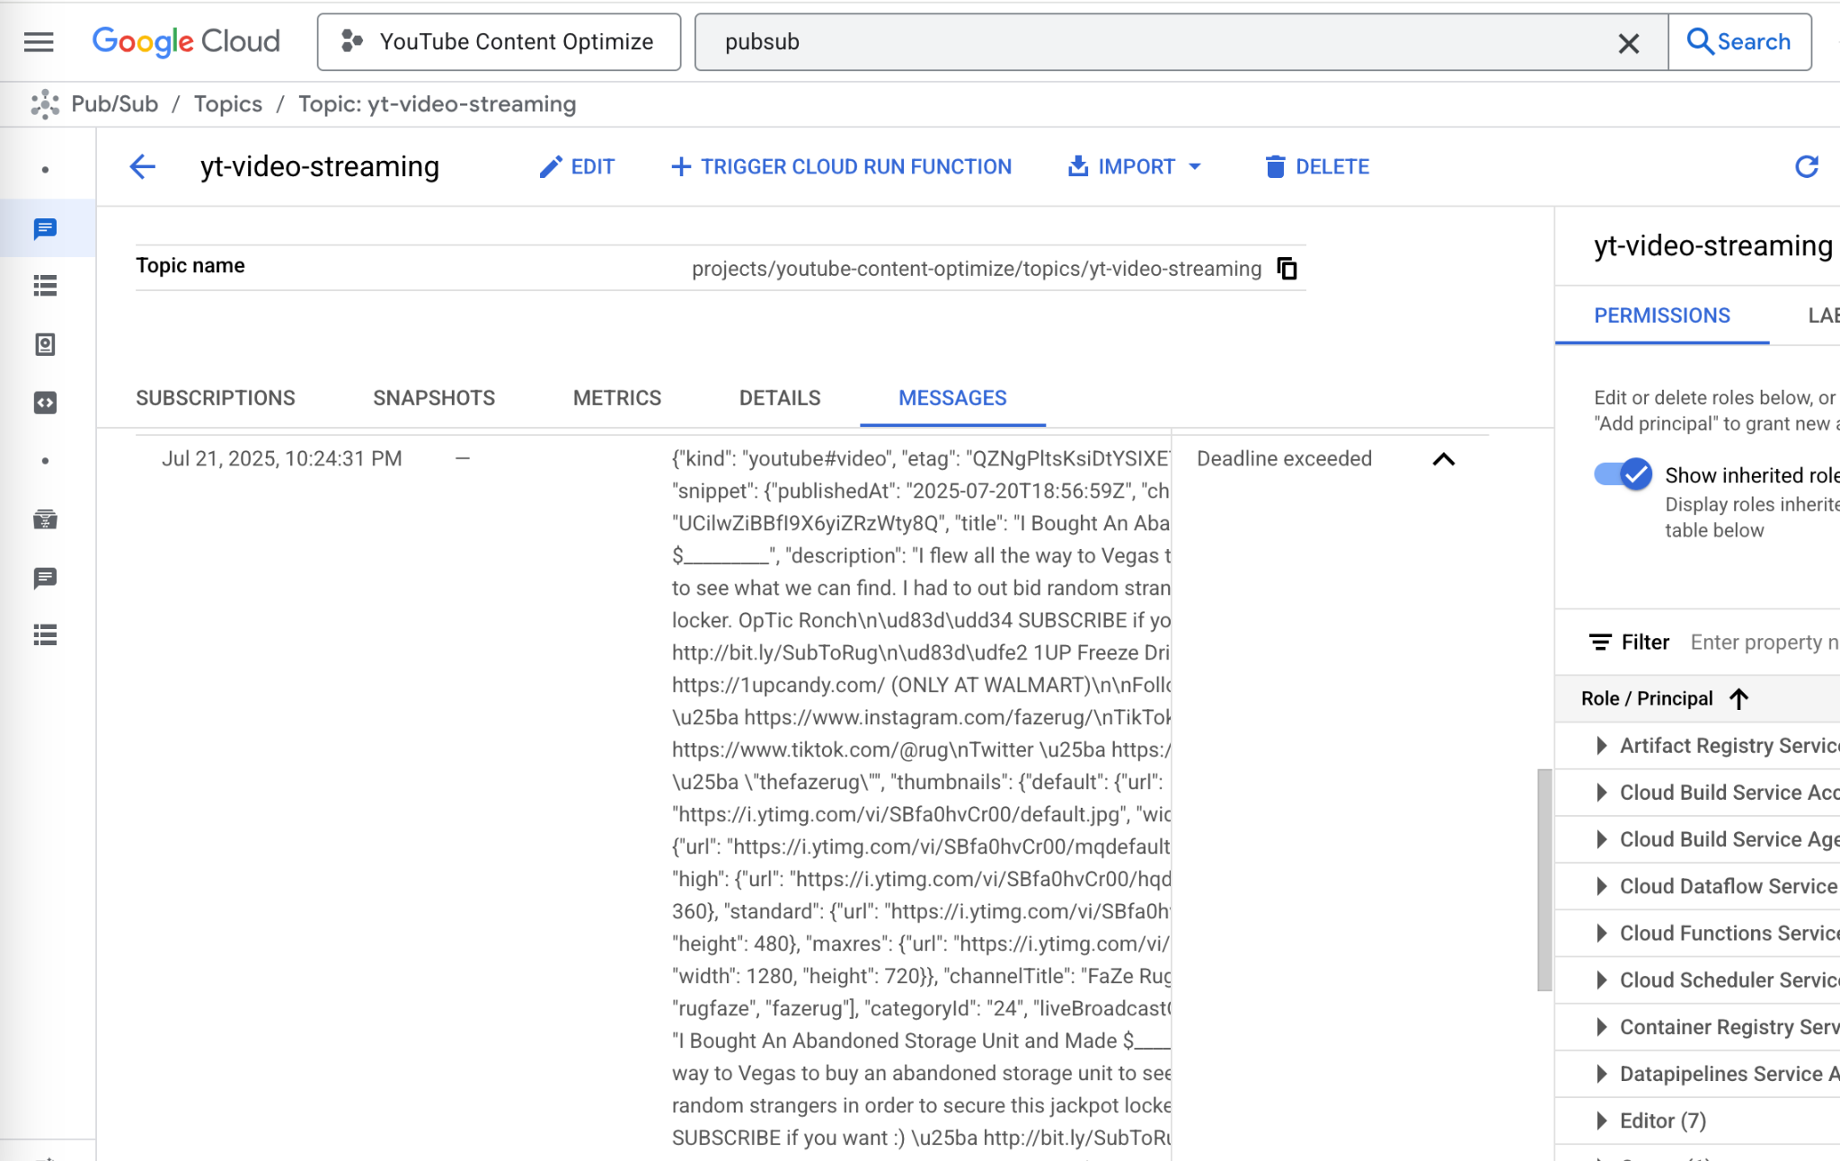
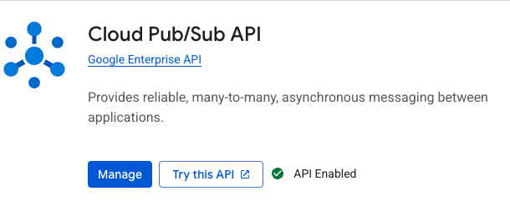
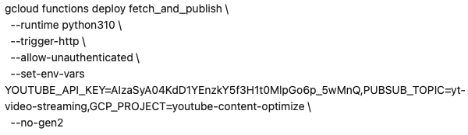
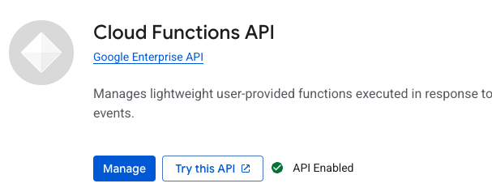
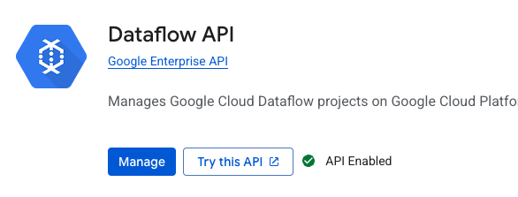
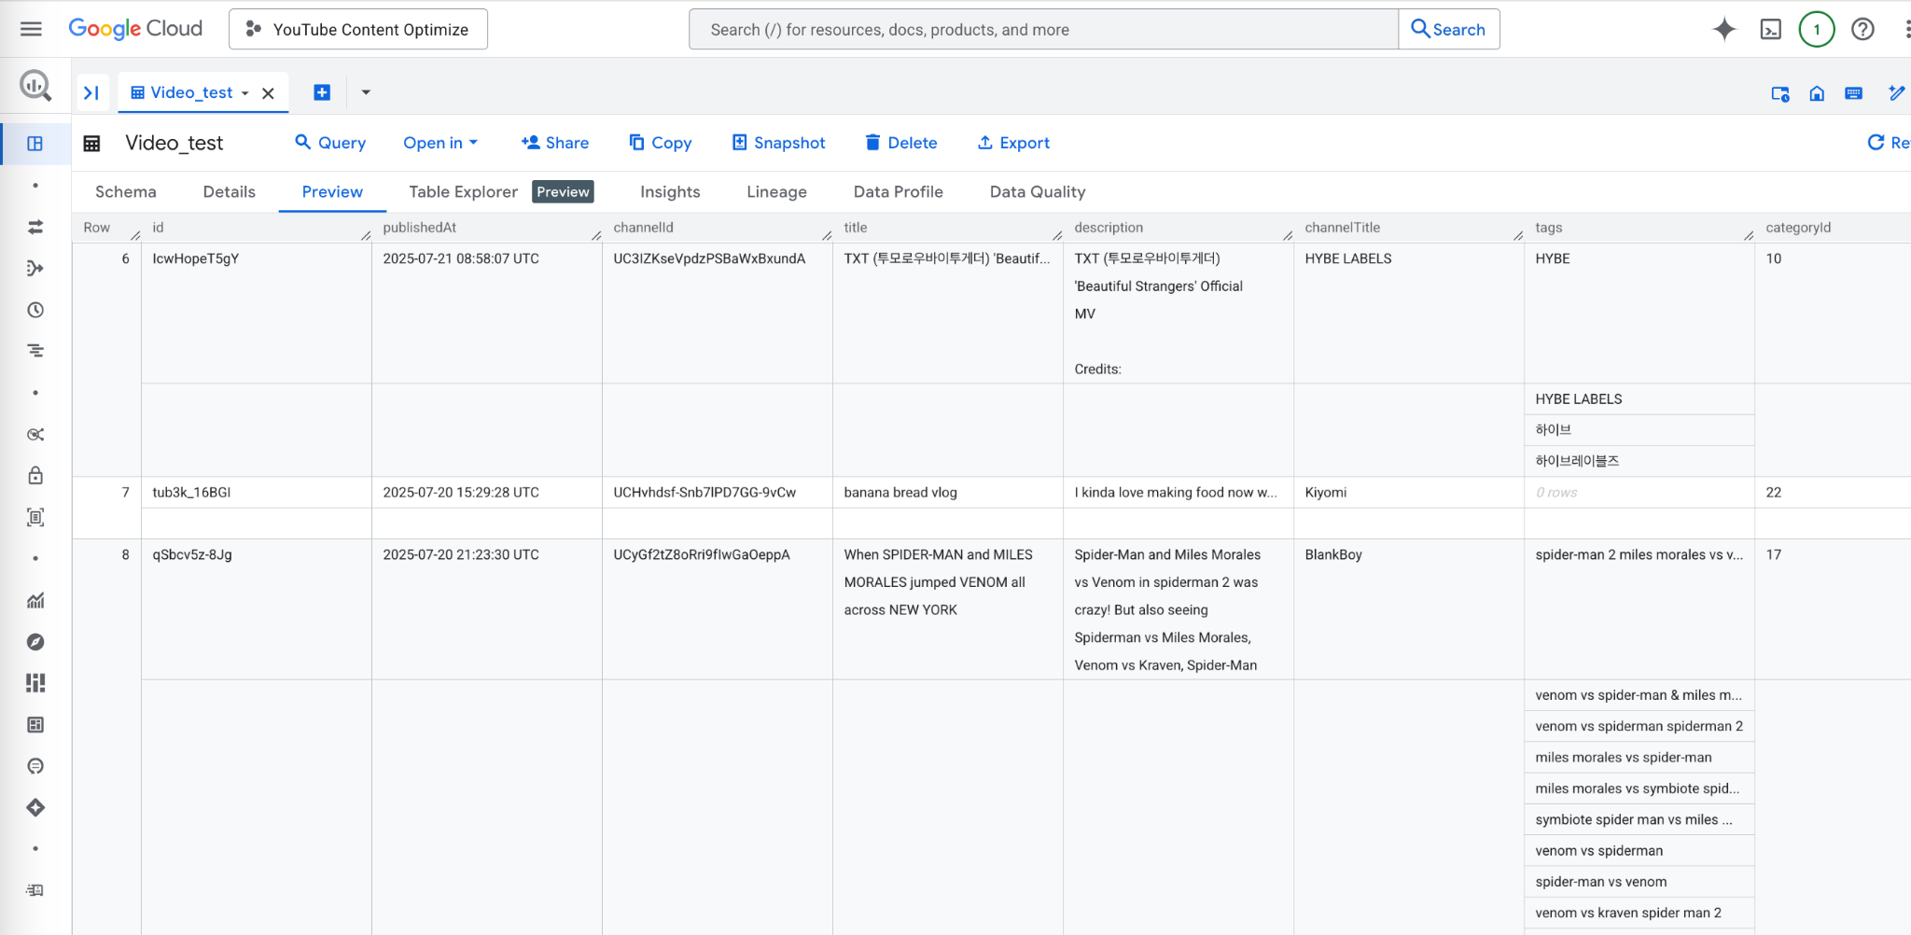
Data Pipeline
API Enabling
Pub/sub Pulling
Cloud Functions
Data Flow Testing
Notes:
These are the main 4 steps

Slide 13
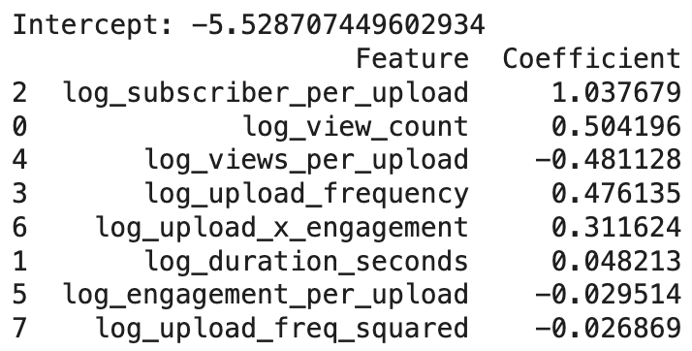
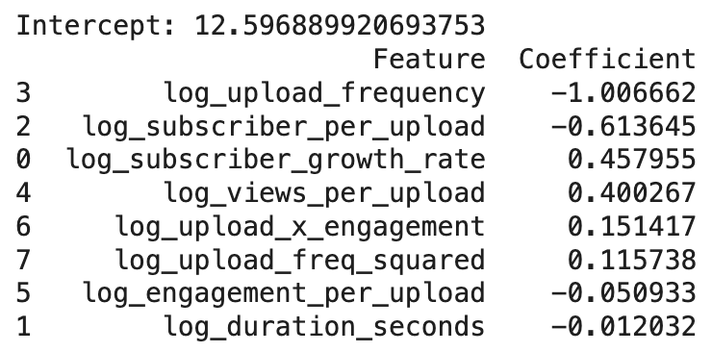
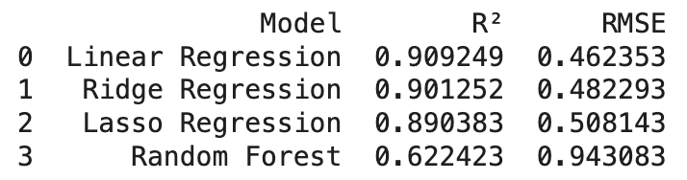
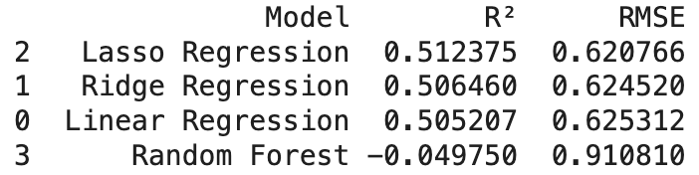
Regression Analysis
Import libraries > Load data from BigQuery > Data cleaning and preprocessing > Feature engineering > Log transformations > Regression modeling
y is log_subscriber_growth_rate
y is log_view_count

Slide 14
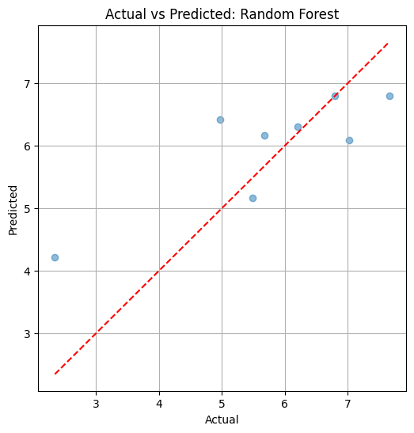
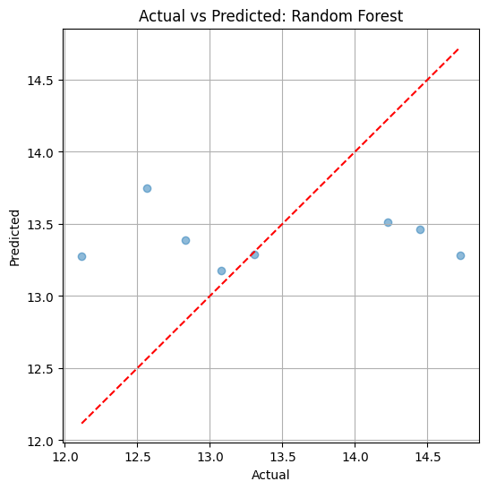
Regression Analysis
Import libraries > Load data from BigQuery > Data cleaning and preprocessing > Feature engineering > Log transformations > Regression modeling > Visualize predictions
y is log_subscriber_growth_rate
y is log_view_count

Slide 15
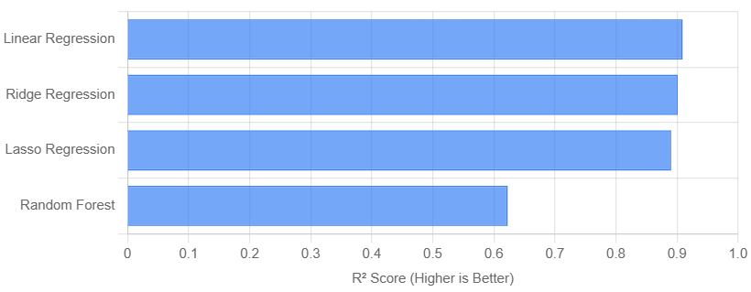
Predicting Subscriber Growth Rate
The linear models (Linear, Ridge, and Lasso Regression) demonstrate very strong predictive power with high R² values, suggesting the engineered features have a strong linear relationship with subscriber growth. The Random Forest model's lower performance indicates it may not be optimally tuned for this specific dataset or that the underlying relationships are indeed primarily linear.

Slide 16
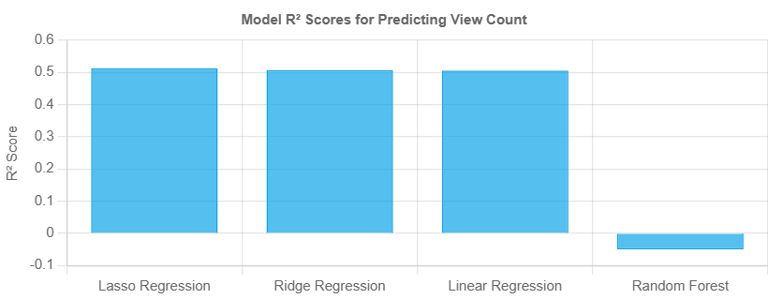
Predicting View Count
The much lower R² scores (around 0.51) indicate that predicting absolute view count is a more complex challenge with this feature set. The engineered features are more directly correlated with the rate of subscriber growth than with total views, reinforcing that these two metrics are driven by different dynamics.

Slide 17
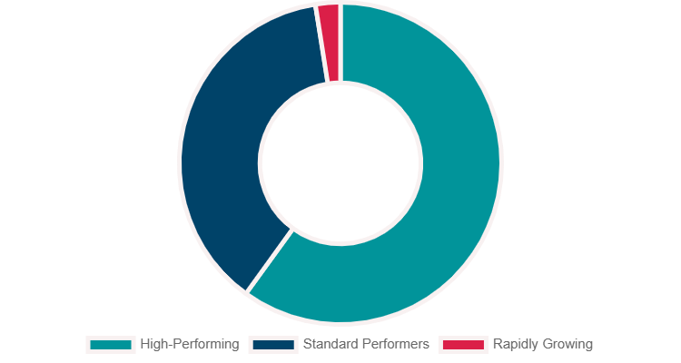
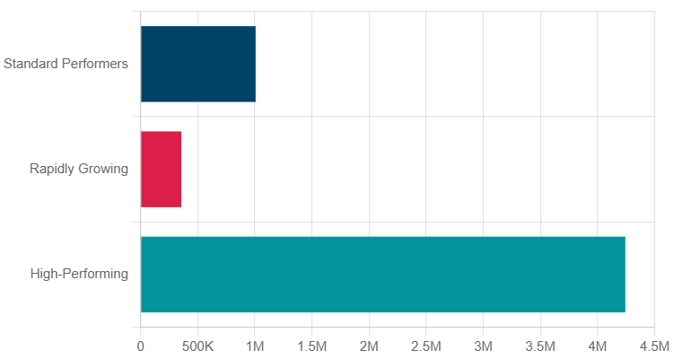
Clustering Analysis
Notes:
Our pipeline is meticulously engineered to facilitate the continuous transfer of YouTube data directly tinto BigQuery, thereby enabling robust, real-time analytics.
The process is initiated by a Cloud Scheduler job, configured to trigger a Cloud Function at high frequency, ensuring timely data ingestion.
Subsequently, the Cloud Function interfaces with the YouTube Data API to procure the most current video data from designated channels.
For each new or updated video event, the Cloud Function publishes a streamlined JSON message to a Pub/Sub topic, a strategic design choice that effectively decouples data ingestion from subsequent processing steps and enhances data durability.
A dedicated Dataflow pipeline, actively subscribed to the Pub/Sub topic, processes these messages in real-time, performing essential initial cleaning, rigorous schema validation, and crucial data enrichment, such as the automatic addition of timestamps.
The impeccably processed data is then immediately streamed into a designated "raw" table within BigQuery, leveraging its inherent streaming insert capabilities, which in turn renders the data instantly available for querying within mere seconds.

Slide 18
Interpretation of Clusters
Cluster 2: High-Performing Powerhouses: This is the largest group. These videos command exceptionally high view counts and have vastly superior engagement and views-per-upload metrics. Their channels, however, do not upload frequently. This cluster represents established, highly successful videos.
Cluster 0: Standard Performers: This group has respectable view counts (averaging 1 million) and long video durations. Their channel growth and upload metrics are modest.
Cluster 1: Rapidly Growing Channels: This is a very small but distinct group of 5 videos. They have the lowest average view counts. However, their defining characteristics are a significantly higher subscriber growth rate and upload frequency. These appear to be from newer, very active channels that are growing quickly but have not yet achieved the high view counts of the other clusters.
Notes:
Our pipeline is meticulously engineered to facilitate the continuous transfer of YouTube data directly tinto BigQuery, thereby enabling robust, real-time analytics.
The process is initiated by a Cloud Scheduler job, configured to trigger a Cloud Function at high frequency, ensuring timely data ingestion.
Subsequently, the Cloud Function interfaces with the YouTube Data API to procure the most current video data from designated channels.
For each new or updated video event, the Cloud Function publishes a streamlined JSON message to a Pub/Sub topic, a strategic design choice that effectively decouples data ingestion from subsequent processing steps and enhances data durability.
A dedicated Dataflow pipeline, actively subscribed to the Pub/Sub topic, processes these messages in real-time, performing essential initial cleaning, rigorous schema validation, and crucial data enrichment, such as the automatic addition of timestamps.
The impeccably processed data is then immediately streamed into a designated "raw" table within BigQuery, leveraging its inherent streaming insert capabilities, which in turn renders the data instantly available for querying within mere seconds.

Slide 19
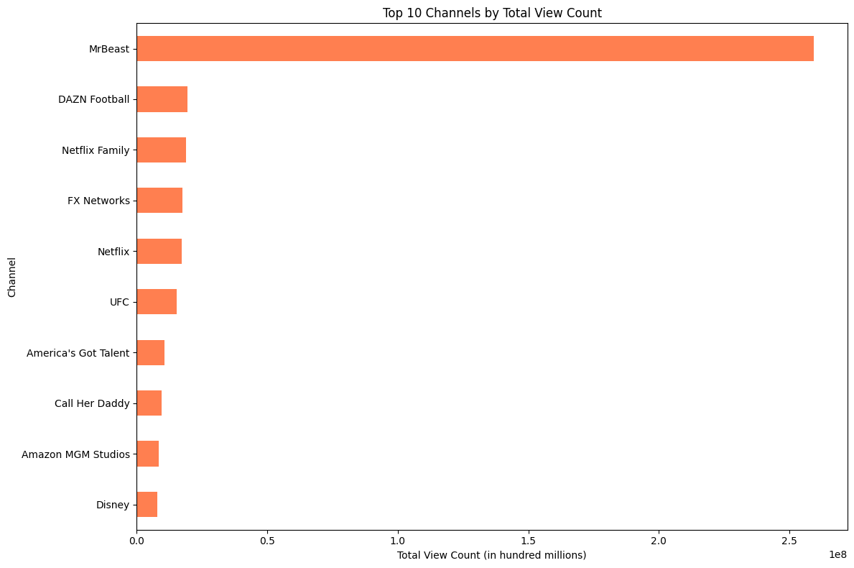
What channels have most views?
Notes:
Our pipeline is meticulously engineered to facilitate the continuous transfer of YouTube data directly tinto BigQuery, thereby enabling robust, real-time analytics.
The process is initiated by a Cloud Scheduler job, configured to trigger a Cloud Function at high frequency, ensuring timely data ingestion.
Subsequently, the Cloud Function interfaces with the YouTube Data API to procure the most current video data from designated channels.
For each new or updated video event, the Cloud Function publishes a streamlined JSON message to a Pub/Sub topic, a strategic design choice that effectively decouples data ingestion from subsequent processing steps and enhances data durability.
A dedicated Dataflow pipeline, actively subscribed to the Pub/Sub topic, processes these messages in real-time, performing essential initial cleaning, rigorous schema validation, and crucial data enrichment, such as the automatic addition of timestamps.
The impeccably processed data is then immediately streamed into a designated "raw" table within BigQuery, leveraging its inherent streaming insert capabilities, which in turn renders the data instantly available for querying within mere seconds.

Slide 20
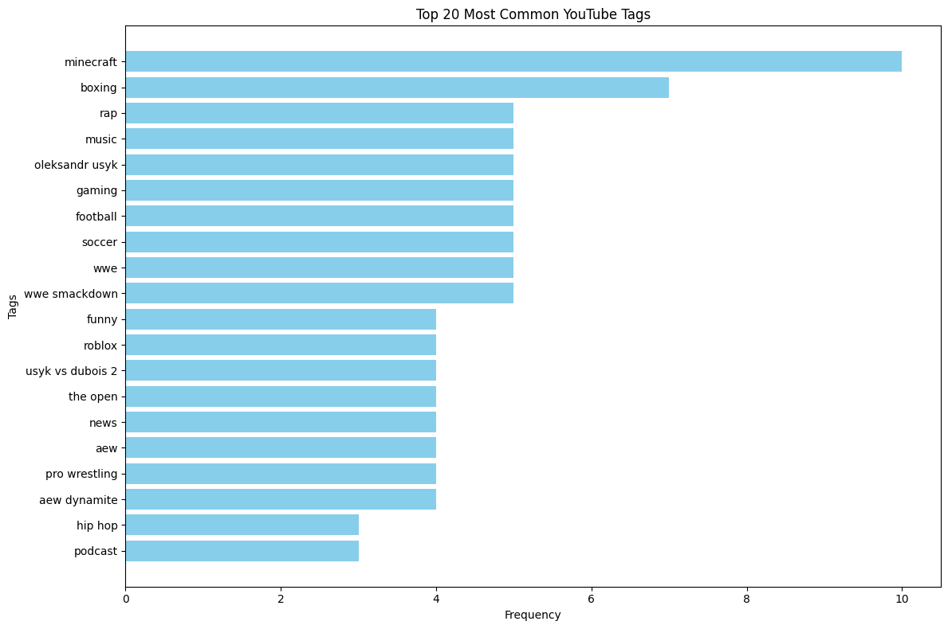
What brands are most popular?
Notes:
Our pipeline is meticulously engineered to facilitate the continuous transfer of YouTube data directly tinto BigQuery, thereby enabling robust, real-time analytics.
The process is initiated by a Cloud Scheduler job, configured to trigger a Cloud Function at high frequency, ensuring timely data ingestion.
Subsequently, the Cloud Function interfaces with the YouTube Data API to procure the most current video data from designated channels.
For each new or updated video event, the Cloud Function publishes a streamlined JSON message to a Pub/Sub topic, a strategic design choice that effectively decouples data ingestion from subsequent processing steps and enhances data durability.
A dedicated Dataflow pipeline, actively subscribed to the Pub/Sub topic, processes these messages in real-time, performing essential initial cleaning, rigorous schema validation, and crucial data enrichment, such as the automatic addition of timestamps.
The impeccably processed data is then immediately streamed into a designated "raw" table within BigQuery, leveraging its inherent streaming insert capabilities, which in turn renders the data instantly available for querying within mere seconds.

Slide 21
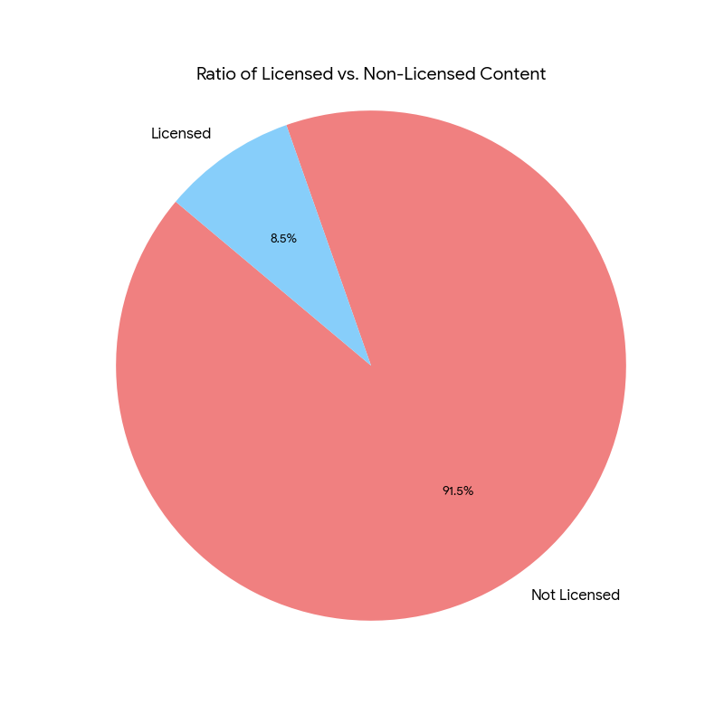
How is licensing used?
Notes:
Our pipeline is meticulously engineered to facilitate the continuous transfer of YouTube data directly tinto BigQuery, thereby enabling robust, real-time analytics.
The process is initiated by a Cloud Scheduler job, configured to trigger a Cloud Function at high frequency, ensuring timely data ingestion.
Subsequently, the Cloud Function interfaces with the YouTube Data API to procure the most current video data from designated channels.
For each new or updated video event, the Cloud Function publishes a streamlined JSON message to a Pub/Sub topic, a strategic design choice that effectively decouples data ingestion from subsequent processing steps and enhances data durability.
A dedicated Dataflow pipeline, actively subscribed to the Pub/Sub topic, processes these messages in real-time, performing essential initial cleaning, rigorous schema validation, and crucial data enrichment, such as the automatic addition of timestamps.
The impeccably processed data is then immediately streamed into a designated "raw" table within BigQuery, leveraging its inherent streaming insert capabilities, which in turn renders the data instantly available for querying within mere seconds.

Slide 22
MrBeast is the most-viewed channel by an enormous margin, with over 259 million views—more than ten times the runner-up.
The most popular content categories are gaming (Minecraft, Roblox), combat sports (boxing, WWE), and music (rap, hip hop).
Besides MrBeast, the top 10 channels are a mix of major sports and entertainment brands, including Netflix, UFC, and Disney.
Content Analysis
Notes:
Our pipeline is meticulously engineered to facilitate the continuous transfer of YouTube data directly tinto BigQuery, thereby enabling robust, real-time analytics.
The process is initiated by a Cloud Scheduler job, configured to trigger a Cloud Function at high frequency, ensuring timely data ingestion.
Subsequently, the Cloud Function interfaces with the YouTube Data API to procure the most current video data from designated channels.
For each new or updated video event, the Cloud Function publishes a streamlined JSON message to a Pub/Sub topic, a strategic design choice that effectively decouples data ingestion from subsequent processing steps and enhances data durability.
A dedicated Dataflow pipeline, actively subscribed to the Pub/Sub topic, processes these messages in real-time, performing essential initial cleaning, rigorous schema validation, and crucial data enrichment, such as the automatic addition of timestamps.
The impeccably processed data is then immediately streamed into a designated "raw" table within BigQuery, leveraging its inherent streaming insert capabilities, which in turn renders the data instantly available for querying within mere seconds.

Slide 23
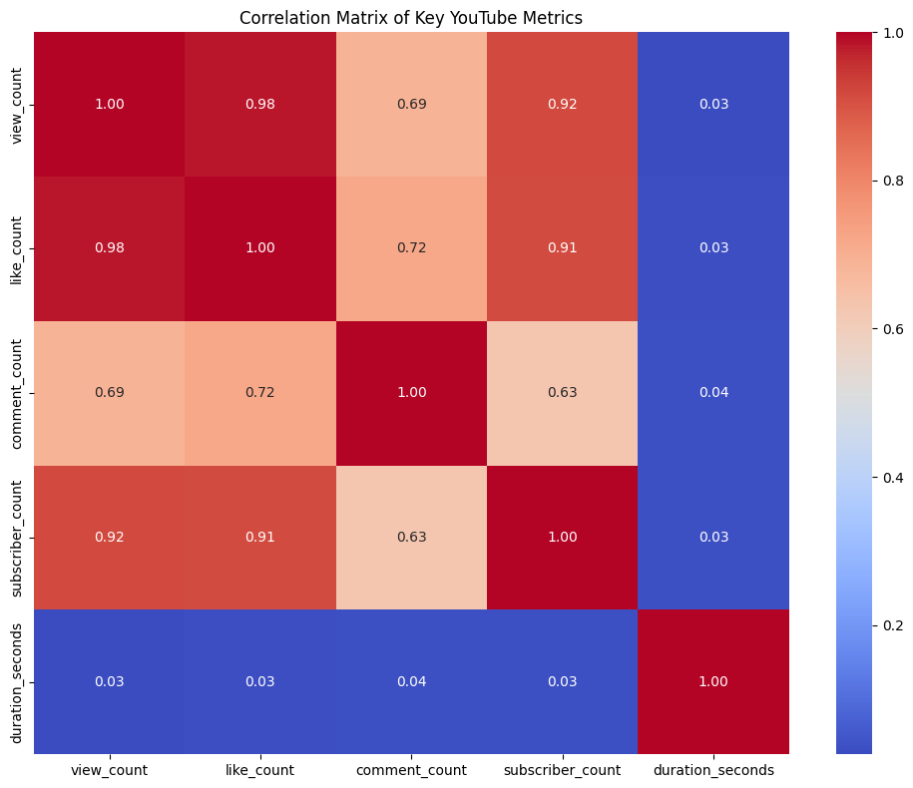
Notes:
Our pipeline is meticulously engineered to facilitate the continuous transfer of YouTube data directly tinto BigQuery, thereby enabling robust, real-time analytics.
The process is initiated by a Cloud Scheduler job, configured to trigger a Cloud Function at high frequency, ensuring timely data ingestion.
Subsequently, the Cloud Function interfaces with the YouTube Data API to procure the most current video data from designated channels.
For each new or updated video event, the Cloud Function publishes a streamlined JSON message to a Pub/Sub topic, a strategic design choice that effectively decouples data ingestion from subsequent processing steps and enhances data durability.
A dedicated Dataflow pipeline, actively subscribed to the Pub/Sub topic, processes these messages in real-time, performing essential initial cleaning, rigorous schema validation, and crucial data enrichment, such as the automatic addition of timestamps.
The impeccably processed data is then immediately streamed into a designated "raw" table within BigQuery, leveraging its inherent streaming insert capabilities, which in turn renders the data instantly available for querying within mere seconds.

Slide 24
Key Engagement Takeaways
There is a strong positive link between views, likes, and subscribers. Popular videos on channels with many subscribers tend to get more views and likes, creating a cycle of growth.
Video length does not directly impact success. A video's duration has a very weak relationship with its view count or other engagement metrics.
Likes suggest a higher level of viewer engagement than Comments, as the correlation between comments and views is not as strong as the one between likes and views.
Ultimately, content is king. Success on the platform is highly dependent on the quality and type of content produced, with unique formulas like MrBeast's high-stakes challenges proving highly effective.
Notes:
Our pipeline is meticulously engineered to facilitate the continuous transfer of YouTube data directly tinto BigQuery, thereby enabling robust, real-time analytics.
The process is initiated by a Cloud Scheduler job, configured to trigger a Cloud Function at high frequency, ensuring timely data ingestion.
Subsequently, the Cloud Function interfaces with the YouTube Data API to procure the most current video data from designated channels.
For each new or updated video event, the Cloud Function publishes a streamlined JSON message to a Pub/Sub topic, a strategic design choice that effectively decouples data ingestion from subsequent processing steps and enhances data durability.
A dedicated Dataflow pipeline, actively subscribed to the Pub/Sub topic, processes these messages in real-time, performing essential initial cleaning, rigorous schema validation, and crucial data enrichment, such as the automatic addition of timestamps.
The impeccably processed data is then immediately streamed into a designated "raw" table within BigQuery, leveraging its inherent streaming insert capabilities, which in turn renders the data instantly available for querying within mere seconds.

Slide 25
Demo Time
Notes:
In this slide, I’ll walk through the key metrics we’ll be using to analyze YouTube content performance.
We're collecting data directly from the YouTube Data API v3, which gives us three major types of information.
Video metadata includes details like ….
Performance metrics cover core engagement indicators such as views, likes, and comments.
And from the channel side, we’re capturing subscriber counts and total video count, when available.
A key derived metric is the engagement rate, calculated as the sum of likes and comments divided by views. This gives a normalized view of how engaging a video is, regardless of total reach.
=
These metrics serve multiple purposes:
They enable category-based segmentation, such as comparing what works best in Music vs. Education.
They help benchmark upload strategies, like optimal title length or best upload times.
Finally, these structured insights also power LLM-based summaries, making it easier for users to ask natural-language questions like ‘What makes a tech video go viral?’ and get meaningful, data-backed answers.
So overall, these metrics form the backbone of our optimization pipeline, connecting raw API data to actionable content strategies.
Deliverables: our final deliverable is a
- Website
- live dashboard showing performance metrics and filters (title, category, tag)
- a chat bot

